Slide 1
Starting at 2pm CST
We know some people of you are still driving home so drive safe and we’ll see you at 2pm CST! If you get home earlier, feel free to take a break until then

Slide 2

Integration of Risk and BIA Findings
Unifying Risk Assessment & BIA for Effective Resilience
Connects risk assessment and BIA to build effective resilience programs. Essential for DRI International certification.
Key Topics
Risk & BIA Relationship
Improved Decision-Making
Real-World Resilience Planning
1
Notes:
Integration of Risk and BIA Findings
Risk Assessment = evaluates threats and vulnerabilities
BIA = measures consequences and recovery needs
Shows how both support resilience
Links risk likelihood with impact severity
Helps set recovery sequencing
Builds stronger resilience planning Example: Store checks storm risk before restocking plan. Cyber example: Org links ransomware likelihood to recovery steps.

Slide 3
CLASS AGENDA
CLASS OBJECTIVES
Linking BIA & risk results
Identifying shared data & dependencies
Building an integrated framework
Real-world integration examples
Explain integration importance
Describe data connection (Risk & BIA)
Apply integration techniques

Slide 4

What Is Risk vs. BIA?
Risk Assessment
Identifies threats & vulnerabilities
Analyzes incident likelihood
Business Impact Analysis
Measures consequences
Defines recovery requirements
Integrating both builds actionable resilience.
Notes:
What Is Risk vs. BIA?
Risk = threats, vulnerabilities, likelihood
BIA = consequences, recovery time, dependencies
Risk predicts what can happen
BIA shows what the impact will be
Together create actionable resilience Example: Storm risk vs. store closure impact. Cyber example: Phishing likelihood vs. email outage impact.

Slide 5

Why Integration Matters
Consistency
Efficiency
Ensures unified organizational response.
Optimizes resource use and coordination.
Prioritization
Informs critical investment decisions.
Notes:
Why Integration Matters
Ensures consistent decisions
Improves resource use
Sets clear priorities
Reduces duplicate work
Supports governance and compliance Example: Company stocks supplies based on outage risk + impact. Cyber example: Security invests in backups based on combined scoring.

Slide 6

Integration Framework Overview
1
2
Risk Assessment
Business Impact Analysis
Identifies threats, vulnerabilities, and incident likelihood.
Assesses consequences, dependencies, and recovery needs.
3
Integrated Strategy
Drives recovery priorities and mitigation investments.
Notes:
Integration Framework Overview
Step 1: Assess threats and likelihood
Step 2: Analyze business impact
Step 3: Build integrated strategy
Aligns protection with recovery needs
Drives budget and planning Example: Warehouse maps fire risk to downtime cost. Cyber example: Firm matches DDoS risk to platform RTO.

Slide 7

Mapping BIA to Risk Scenarios
Connect BIA results to risk scenarios for prioritized protection.
BIA Identifies
Critical functions, dependencies, and recovery time objectives (RTOs).
Risk Assessment Identifies
Specific threats and their likelihood of occurrence.
Integration Example
Critical payroll system ➞ Ransomware threat.
Notes:
Mapping BIA to Risk Scenarios
BIA shows critical functions
Risk shows likely threats
Map threats to critical systems
Prioritize controls and recovery
Strengthens planning accuracy Example: Payroll risk mapped to power outage scenario. Cyber example: Ransomware mapped to most critical systems.

Slide 8

Using Risk Data to Validate BIA Results
Use comprehensive risk data to ensure accurate and relevant Business Impact Analysis (BIA) findings.
Validate Assumptions: Confirm BIA assumptions with risk likelihood data.
Adjust Priorities: Modify recovery priorities based on actual risk levels.
Ensure Consistency: Align risk assessments with BIA findings.
Notes:
Using Risk Data to Validate BIA Results
Check BIA assumptions with likelihood data
Adjust recovery priorities
Confirm consistency across teams
Update plans when risk changes
Improve accuracy Example: Store adjusts priorities after storm probability rises. Cyber example: Cloud outage risk adjusts app recovery order.

Slide 9

Shared Data Points: Risk & BIA
Risk Data
Threats
Vulnerabilities
Likelihood
BIA Data
Impact
Dependencies
RTOs
Integration Benefits
Unified Priorities
Aligned Resources
Funding Justification
Notes:
Shared Data Points: Risk & BIA
Risk: threats, vulnerabilities, likelihood
BIA: impact, dependencies, RTOs
Shared data improves accuracy
Aligns resources and funding
Builds unified resilience view Example: Store links supplier risk to delivery impact. Cyber example: Security risk score linked to system RTO.

Slide 10

Common Challenges
1
2
Data Format Issues
Departmental Silos
Inconsistent scoring models and disparate data formats.
Organizational barriers hinder cross-functional collaboration.
3
Unclear Ownership
Undefined roles and responsibilities for coordination.
Notes:
Common Challenges
Different scoring formats
Department silos
Unclear ownership
Poor data sharing
Conflicting priorities Example: Finance and Ops use different scoring scales. Cyber example: IT and security use separate risk tools.

Slide 11




Governance and Ownership
Joint Committees
Defined Roles
Cross-functional groups to oversee risk-BIA integration.
Clear responsibilities for risk & continuity coordination.
Shared Reporting
Unified systems for consistent data & decisions.
Notes:
Governance and Ownership
Create joint committees
Assign clear roles
Use shared reporting systems
Standardize data models
Improve cross-team accountability Example: Store managers and finance meet monthly on risks. Cyber example: Security + continuity team share one dashboard.

Slide 12

Integration Example — Financial Sector
Risk Assessment
Identified data breach fines as high-impact, medium-likelihood risk.
BIA Findings
Payment systems critical: 2-hour RTO.
Integration Outcome
Enhanced security controls meet RTO & regulatory needs.
Notes:
Integration Example — Financial Sector
Risk shows high-impact fines
BIA shows 2-hour RTO for payments
Combined data drives stronger controls
Meets regulatory expectations
Protects revenue and trust Example: Bank upgrades generator for critical branch ops. Cyber example: Payment fraud risk drives rapid restore design.

Slide 13


Integration Example — Technology Firm
Risk Assessment
Cloud outage: 15% annual probability, high impact.
BIA Analysis
SaaS disruption: $50K/hour revenue loss.
Integration Strategy
Multi-cloud redundancy based on risk-BIA findings.
Notes:
Integration Example — Technology Firm
Cloud outage probability identified
BIA shows $50K/hour loss
Multi-cloud chosen as mitigation
Strategy based on both data sets
Improves uptime resilience Example: App company adds backup internet line. Cyber example: SaaS firm deploys region failover cluster.

Slide 14
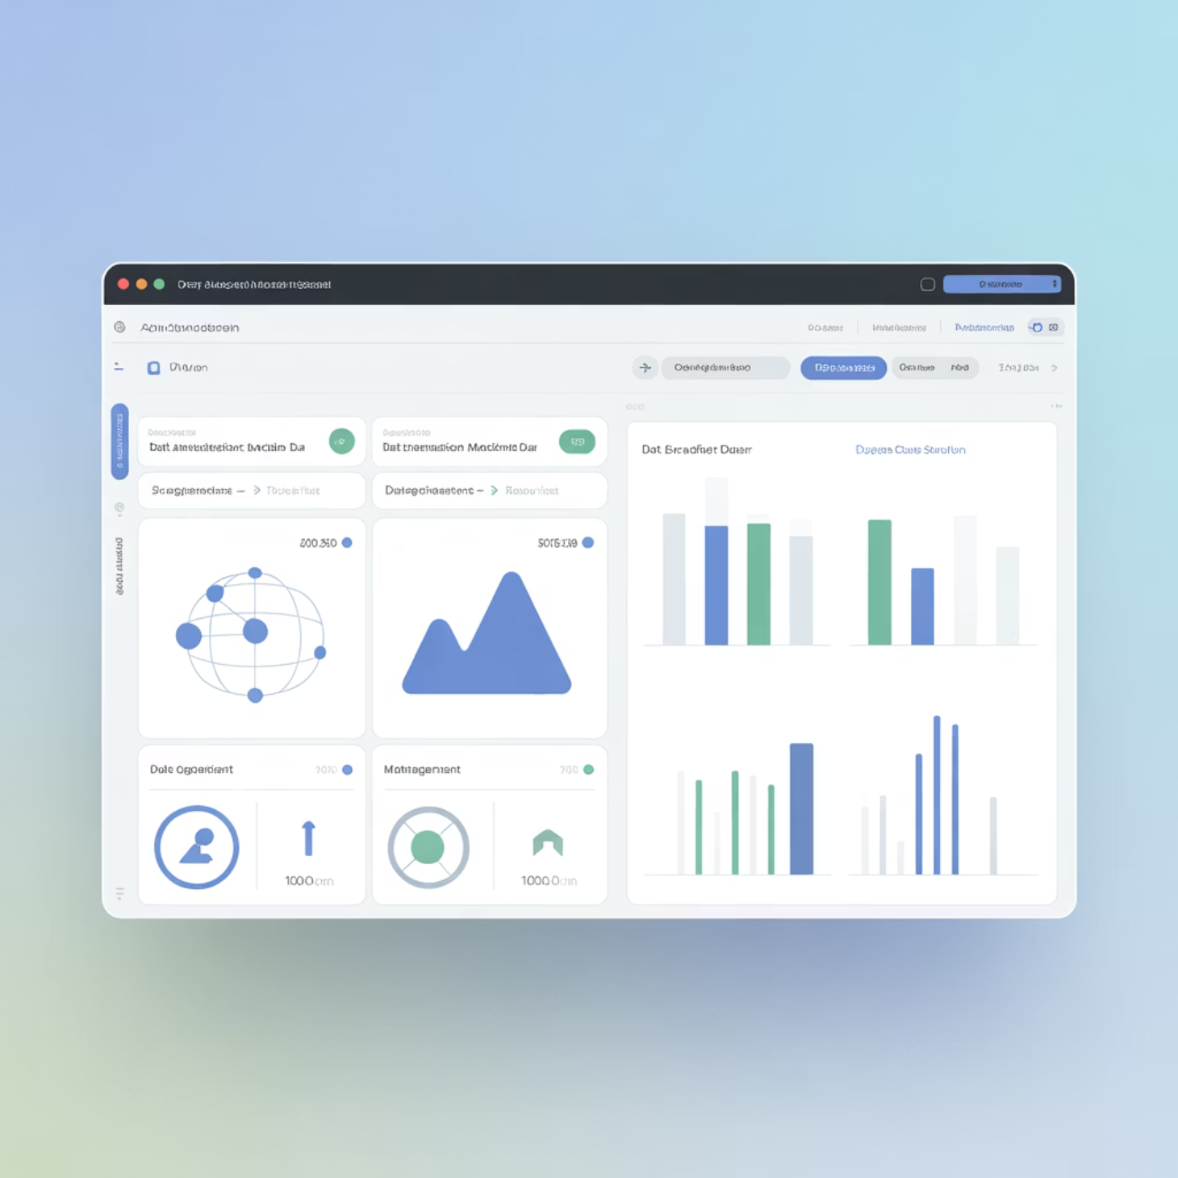
Tools That Support Integration
Unified platforms enhance resilience.
Integrated Platforms Tools like Archer, Fusion, & ServiceNow offer unified risk/BIA dashboards.
Data Centralization Ensures data consistency and reduces conflicts.
Traceability Features Audit trails & data lineage aid compliance & improvement.
Notes:
Tools That Support Integration
Unified GRC/resilience platforms
Centralized data storage
Shared dashboards
Audit and traceability features
Reduces conflict between teams Example: Store uses one tool for inventory + risk tracking. Cyber example: Firm uses Archer/Fusion for risk + BIA.

Slide 15

Key Integration Benefits
Enhanced Accuracy: Unified data leads to consistent, higher-quality assessments.
Proactive Mitigation: Combined insights enable preventive actions, reducing reactive responses.
Resilience Maturity: Integrated approach builds confidence in program effectiveness.
Notes:
Key Integration Benefits
Better accuracy
Stronger mitigation
Higher resilience maturity
More proactive planning
Improved leadership confidence Example: Company adjusts plans before storm season. Cyber example: IT fixes cloud gaps before outage hits.

Slide 16

Summary and Key Takeaways
Unified Approach: Seamlessly integrates proactive risk and reactive business analysis.
Enhanced Coordination: Improves cross-department collaboration between risk and continuity teams.
Faster Recovery: Enables quicker, data-driven recovery actions.
Stronger Governance: Boosts resilience program governance and organizational maturity.
Remember: Integrated resilience protects and strengthens organizational capabilities.
Notes:
Summary and Key Takeaways
Integrates proactive risk with reactive BIA
Strengthens team coordination
Supports faster recovery
Builds stronger governance
Improves overall resilience Example: Store protects both supply chain and checkout. Cyber example: Security aligns threat intel with RTO/RPO.

Slide 17
BREAK TIME
Be back in 15 mins.

Slide 18
Lab Time
1 Hour

Slide 19
Project Time
1 Hour

Slide 20
Kahootz & Quiz Time

